Slide 1
CREATING VALUE FROM DATA
Supporting decision-making with business intelligence (BI)

Slide 2

Daniel Chamberland-Tremblay, Ph. D.
B. Sc. Biology, Mcgill U.
M. Sc. Geomatics, U. Laval
Ph. D. Computer Science, UdeS
Prof. MIS/BI at École de Gestion, UdeS

Slide 3
Facts matter…

Slide 4
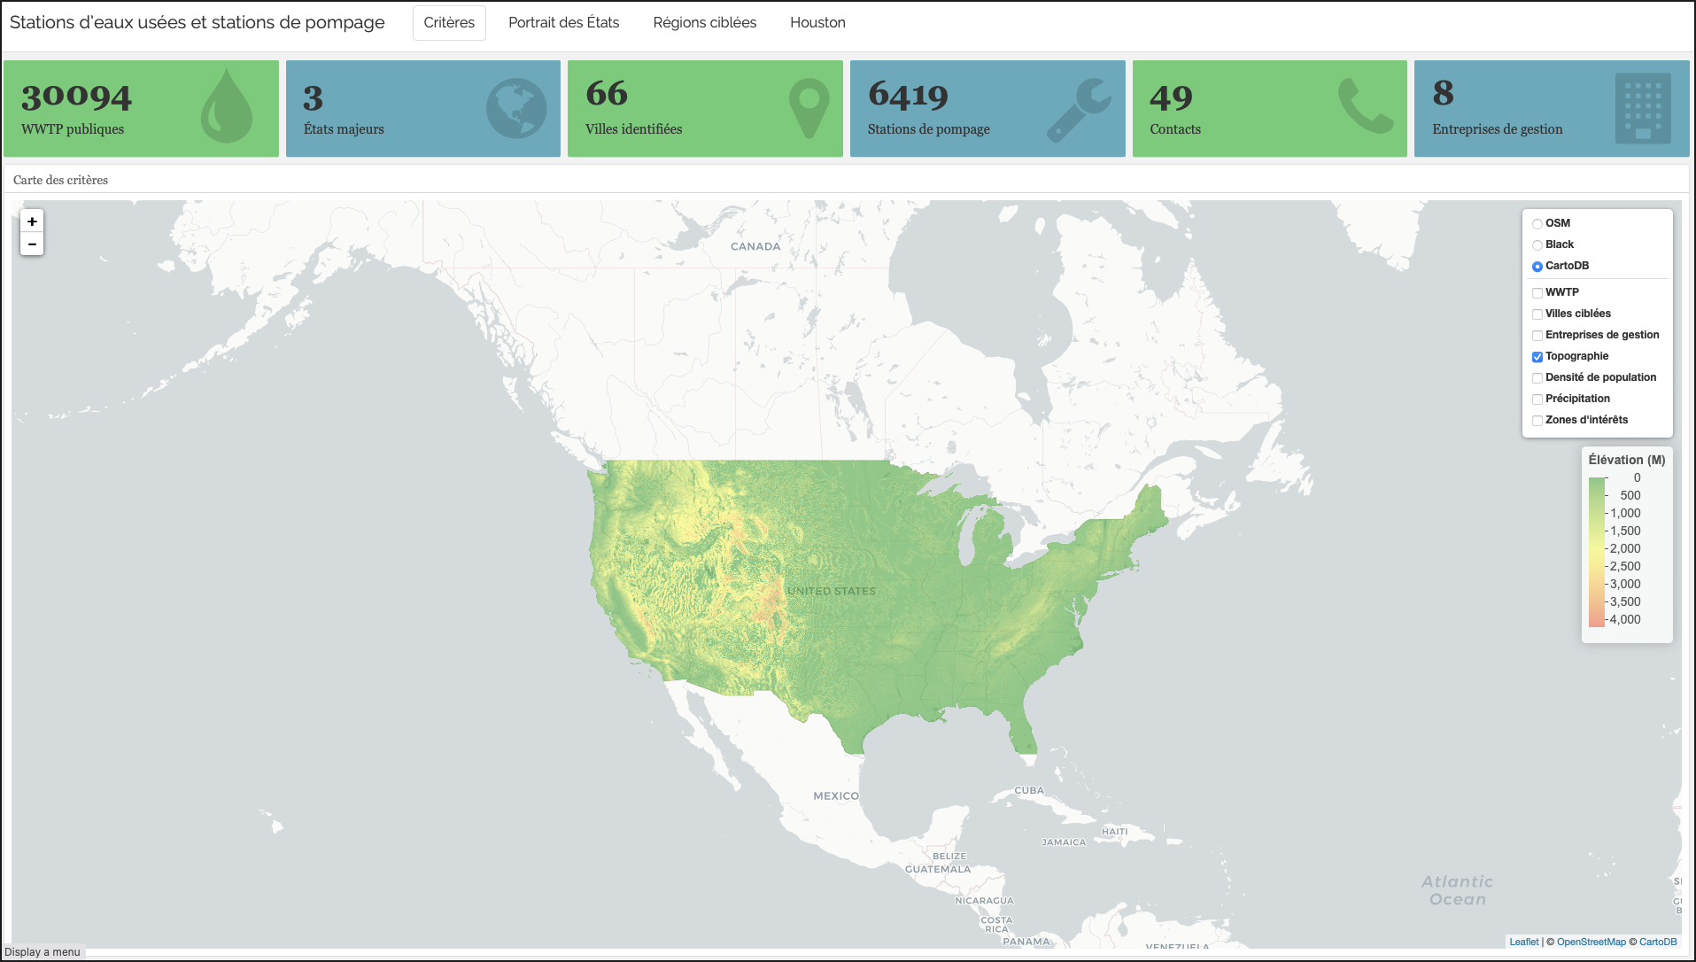
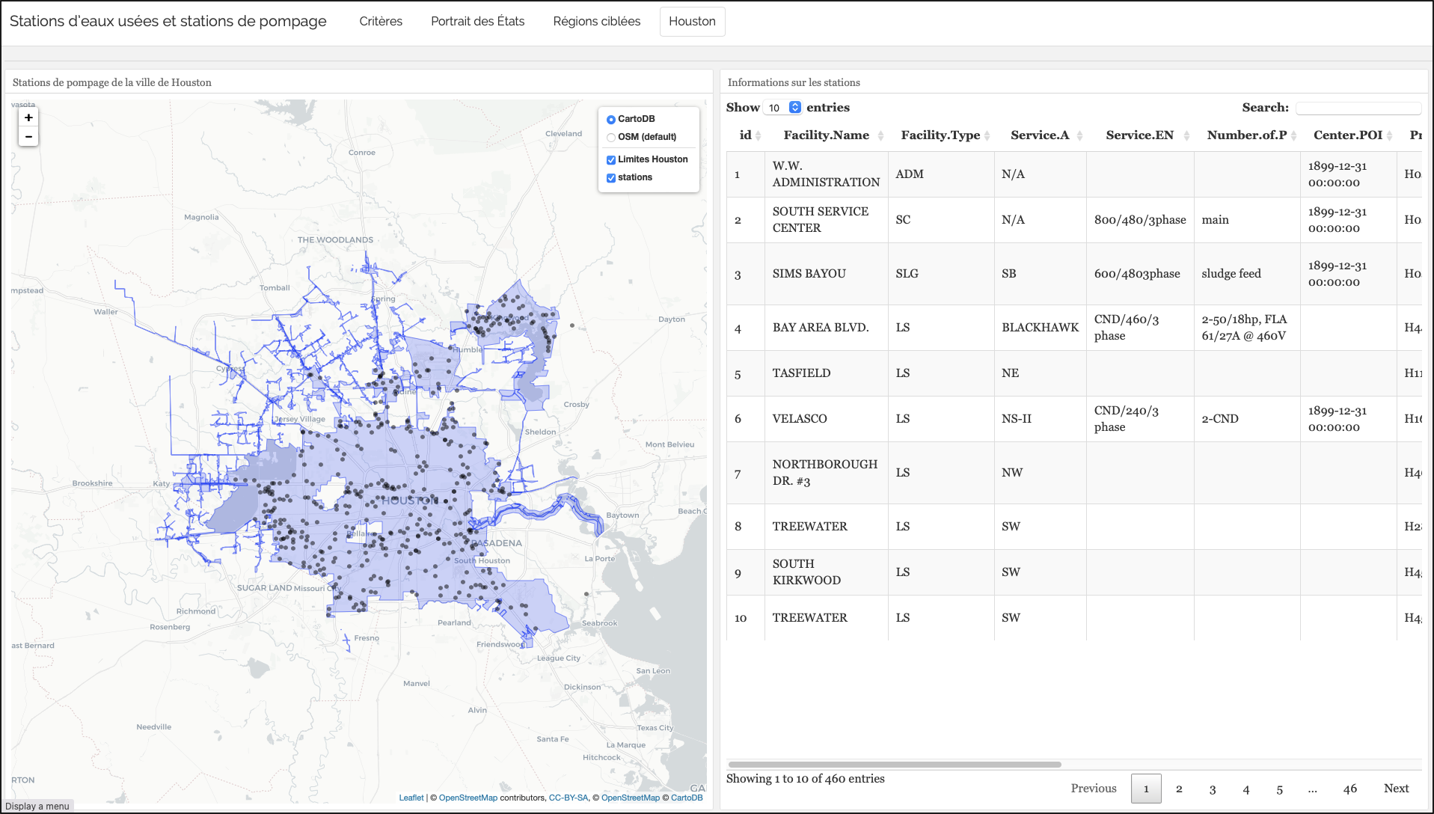
… so you want to create a data product?

Slide 5
… so you want to create a data product?
Is your data product static, dynamic, temporal, spatial, self-service?
Do you have access to quality data?
Can your client handle of your data product?
Are your users proficient with data? With data applications ?
Is the goal to explore, detect, explain, monitor, predict, or convince?

Slide 6
Exercise 1
To the best of your understanding, answer the following questions individually:
Who is your client?
Who is your final user?
Are the data at your disposal ready to use?
What data product are you designing?
What is the goal of that data product?
After the data product delivery, then what?

Slide 7
INSIGHT
People taking decisions often look for a simple(r) answer to complex issues

Slide 8
Using BI : from data to value creation
Presentation plan
A brief definition of BI
Applying BI to the creation of a data product
From a process perspective
From a data and systems perspective
From a business perspective
Revisiting your data product through the BI lenses

Slide 9
What is BI ?

Slide 10
Business Intelligence
Business Intelligence (BI) aims at
Consolidating,
Validating and
Cleaning … data from various sources in order to
Offer reliable valuable-added information … under the appropriate form and channel to
Communicate eloquently,
Collaborate efficiently, and
Support better decision-making

Slide 11
Business Intelligence
To do so, Business Intelligence (BI) is defined as
« … a combination of processes, policies, culture, and technologies for gathering, manipulating, storing, and analyzing data collected from internal and external sources, in order to communicate information, create knowledge, and inform decision making. »
The is more than the data product when it comes to creating value from data… the product is only the tip of the iceberg
Foley & Guillemette, 2010

Slide 12
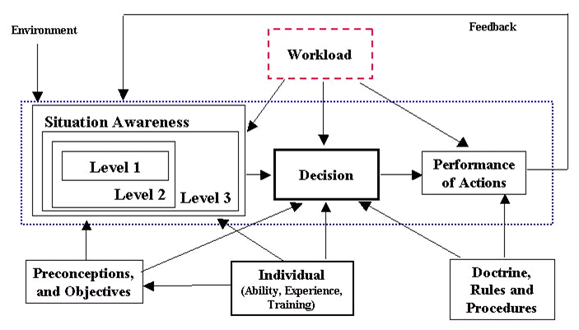
Creating value Through A better Understanding
Awareness levels:
Level 1: Perception
Level 2: Comprehension
Level 3: Projection
Source : Endsley, 1995

Slide 13
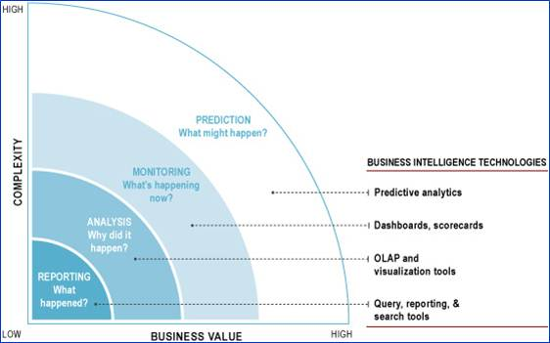
Creating value THROUGH the right People-Process-technology combination
Source : https://www.supportpro.com/

Slide 14
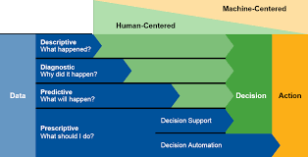
Creating value THROUGH the right People-Process-technology combination
Source : Gartner

Slide 15
Addressing BI through different perspectives

Slide 16
BI AS a Technological proposition

Slide 17
The data architecture
Access all the data (more data, means for possibilities)
Integrate data (share a common understanding and a common access)
Analyse data, decide and communicate (increase analysis capabilities, reduce uncertainty)
Improve data in incremental steps (reuse the data archiveture for more efficiency)

Slide 18
BI REFERENCE Architecture
Manage complexity for the user
Create valuable data products
Ensure the quality of your resource

Slide 19
BI Data Lake Architecture
Ensure shared understanding of data
Create valuable data products
Account for data velocity, volume and variety

Slide 20
A TEchnology Architecture to avoid
Avoid uncleaned data
Avoid mixing data preparation and visualization
Avoid data silos

Slide 21
Takeaways
Each layer in a data architecture has a functional purpose that has to be accounted for in the creation of data products
A layer can be physical (ex. database) or conceptual (ex. a script), but it must be devoted to its purpose (no mixing)
Data models matter (ex. traceability, performance)
The larger the project, the more physical the architecture
The larger the project, the more formal a layer becomes (ex. documentation, management processes, data steward)
A proof-of-concept should NOT be implemented in production

Slide 22
BI AS a process

Slide 23
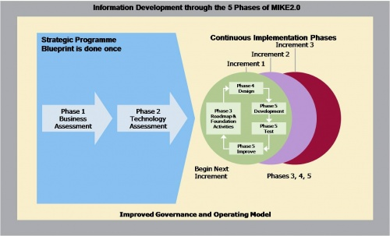
Creating a data product is an iterative process
Gap analysis and project planning
Allow for agility
What is readily possible
Make sure your data product outlives the project
Source: http://mike2.openmethodology.org

Slide 24
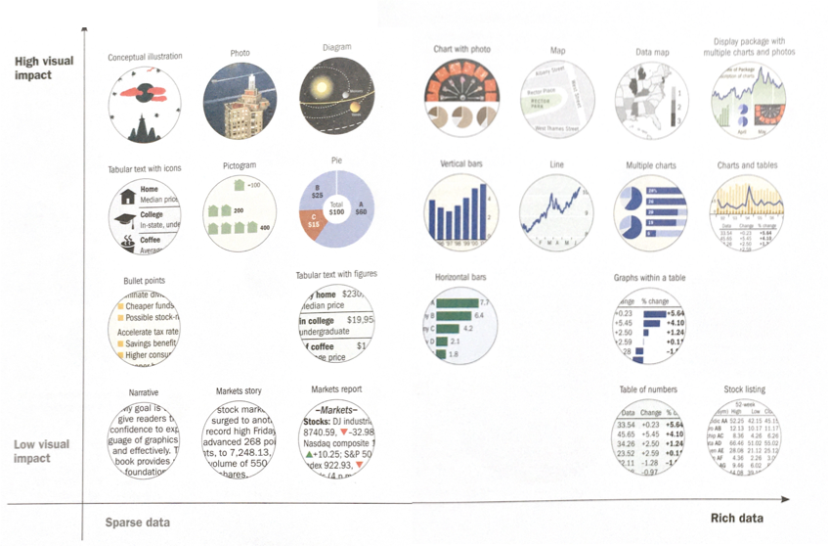
Digital literacy may play a role in choosing the right data product
Iteration 3
Iteration may also be a way to drive change
Example
Iteration 1
Iteration 2
Remember that people ask for what they know
Source: Wong, 2010

Slide 25
Exercise 2
Assess the strategic blueprint of your client, by expanding on the following questions:
Why is a data product required?
Who is in charge of managing the project at your client’s?
What are the essential features of your data product? What are the nice-to-have? According to whom?
What are the planned iterations?

Slide 26
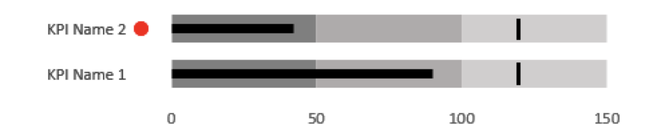
On choosing measures and KPIs
A good measure…
Fulfills a clear and important (business) requirement
Offers a space for action
Communicates organizational priorities
Drives activities
Supports communication and collaboration
Is understood and shared by most people
Can be trusted
A KPI is a measure with a target

Slide 27
On choosing measures and KPIs
A measure can be…
Simple
Nb. litters of water used per household in a year
Nb. of hectares regenerated by year
Nb. of kilometers travelled by truck as compared to train for a certain product in a month
Composite
Ecological footprint of an individual
Sustainable development score of a corporation
Corruption index of a country

Slide 28
On choosing measures and KPIs
A measure can be…
Leading
Tons of CO2 produced to date this year
Nb. of hectares regenerated to date compared to this year target
Nb. of affiliations to a governmental energy program as of now compared to the target
Lagging
Sq. kilometers of Amazonian deforestation last year
Nb. of people without a residence on July 1st as compared to the previous year
Nb. of GHG tons reduction as compared to the previous five years

Slide 29
Exercise 3
From data to measures:
What are the measures or KPIs you plan to include in your data product?
Are they simple or composite measures?
Are they leading or lagging measures?
Are they measures or KPIs? How is the target decided?
Can you suggest improved measures or KPIs? If not, what data would you need to implement an improved version of your measures?

Slide 30
Takeaways
Data product development should be user-centered
Data product development is a highly iterative process
To be a success, the data product should be central to the activities of the organization
What is dreamt of, may not be readily possible. The organization must then evolve to make it possible

Slide 31
BI AS a culture

Slide 32
There are many Reasons to give access TO DATA
Offer to end users a trust-worthy, useful, value-added, centralized, normalized and integration data product
Provide simple, yet powerful, reporting abilities
Increase end user independence and autonomy (self-service)
Democratize data access
Simplify data access
Optimize the analytical cycle

Slide 33

Beware OF the Changing balance of Power
An initiative to open up data access, just as any organizational change, must be actively managed
It brings visibility to situations and people
It offers detailed information on specific situations
It forces adaptation and change

Slide 34
obstacles and issues to BI implementation
Digital culture and corporate support
Digital literacy
Multiplicity of perspectives (ex. science, politics, business)
Refereeing in decision
Data governance and management
Internal capabilities
Organizational network
Evolution of needs
Analysis paralysis
Blind tasks
ROI…

Slide 35
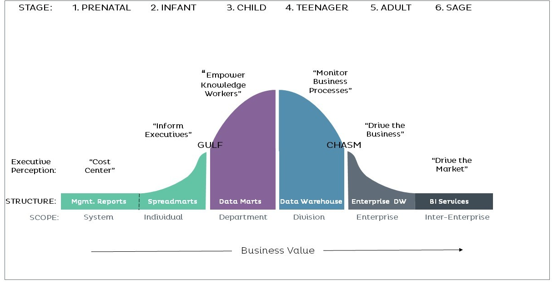
obstacles and issues to BI implementation
Source: TDWI.org

Slide 36
FROM DATA Focus to BI Focus
Support BI maturity management
Governance (from ad hoc to formal and optimized)
Culture (from gut feeling to evidence-based management)
Organization (from informal to integrated)
Vision and Strategy (from awareness to data strategy)
Processes (from manual to formal and reviewed)
Architecture (from independent data sets to full-blown architecture)
Technology (from one size fits all to servicing specific needs)
Business value (from cost measurement to value generation)
Etc.

Slide 37
Takeaways
Data is an organizational asset that must be managed
Data management is an expertise
Data development must be part of the culture of the organization
Data-driven decision depend on multiple organizational dimensions that can evolve with time
Data initiative may fail due to organizational issues

Slide 38
CREATING meaningful Data products

Slide 39
Defining the needs
Decision-makers and data enthusiasts may want to
Detect anomalies
Monitor processes
Understand a situation
Predict events or occurrences
Prescribe a actions to be taken
It may lead to a unified understanding, a better decision-making process or an improved organizational performance

Slide 40
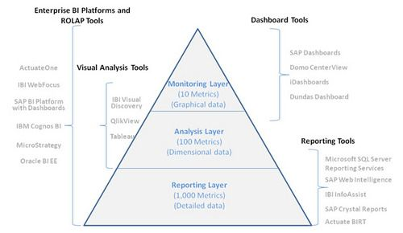
ARE YOU M.A.D. ?
Thinking a data product through the M.A.D. framework helps identify its goal and is functionality
Monitor
Analyse
Drill

Slide 41
Most data development is an iterative Process
Data product development should:
Be based on a user-centered process
Include a gap analysis (and feasibility assessment)
Use an iterative development strategy
Serve important processes and priorities
Be managed as an organizational change

Slide 42
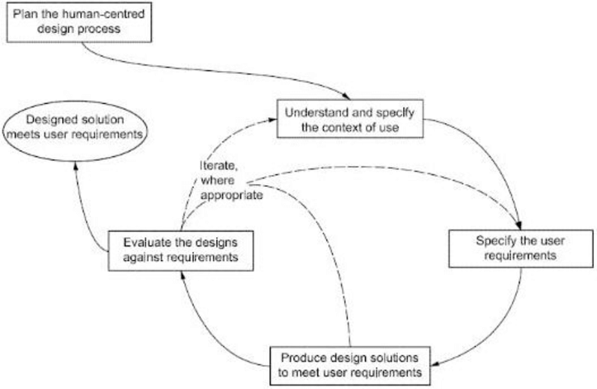
BI vs. USER-Centered Development
ISO 9241-210
MIKE2.0 (general)
Source: iso

Slide 43
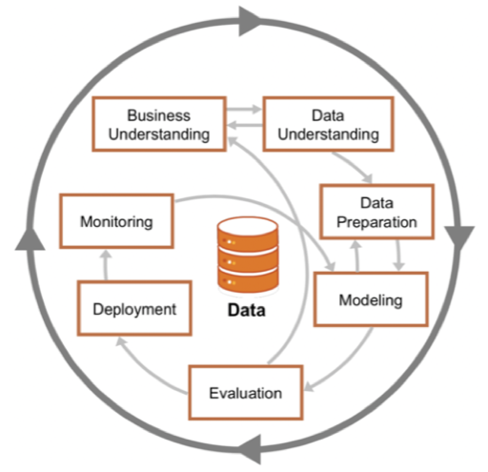
BI vs. Data Science
CRISP-DM
MIKE2.0 (general)
Source: ibm

Slide 44
BI in Action

Slide 45
Visualization : Why and what
Objectives
Analyze
Understand
Inform
Communicate
Persuade
Illustrate
Structure
Phenomena
Trend
Relationship
Composition

Slide 46
The audience
Do they have an interest?
What is their subject-matter literacy?
What is their data/digital literacy?
Are they on a journey from awareness to engagement to action?

Slide 47
Choose the right approach for the right need
Source : https://www.supportpro.com/

Slide 48

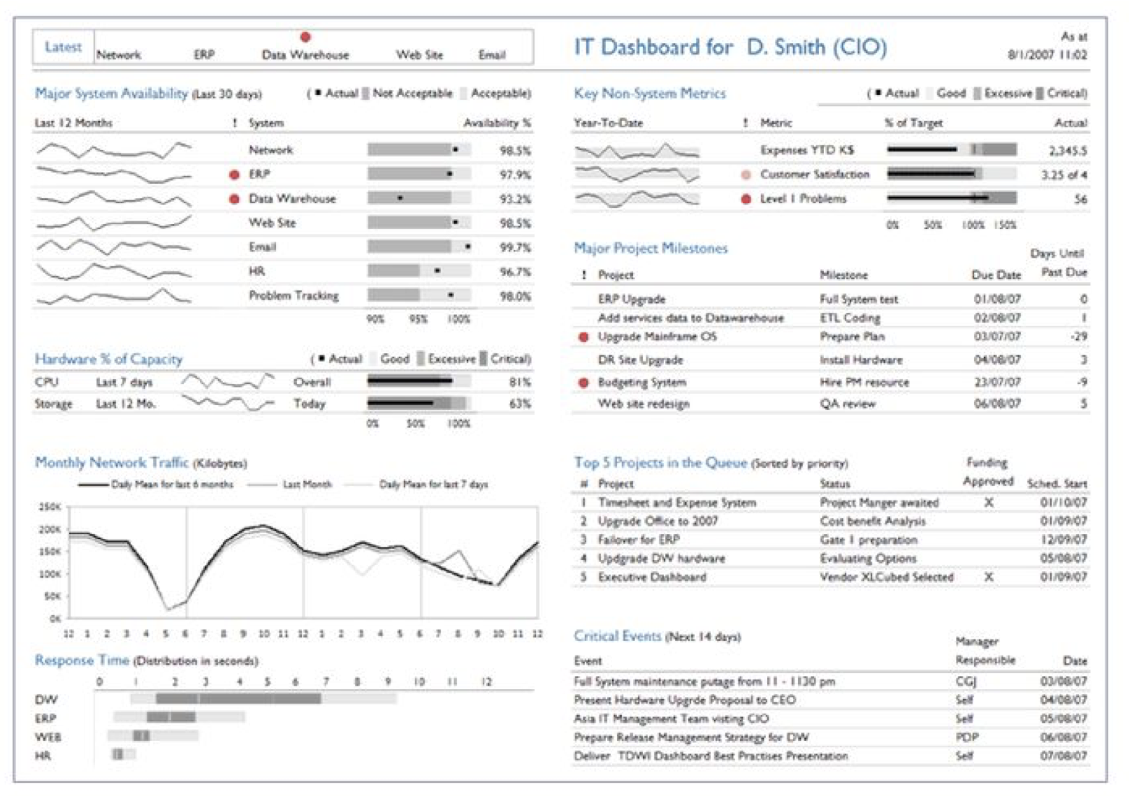
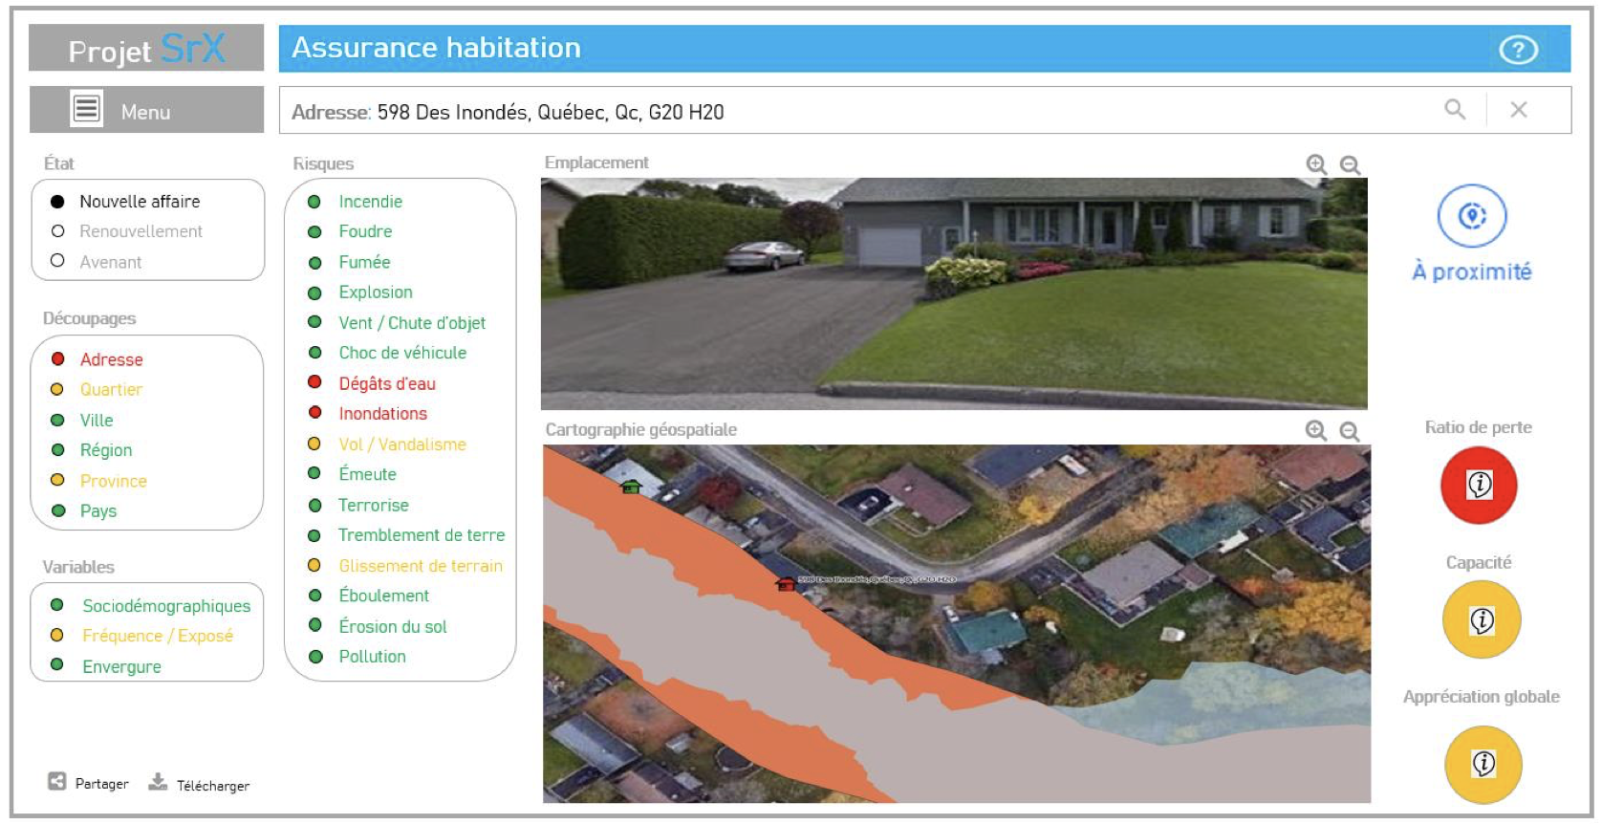
Raise awareness with infographics
Monitor with a dashboard
Analyse with a decision support system

Slide 49
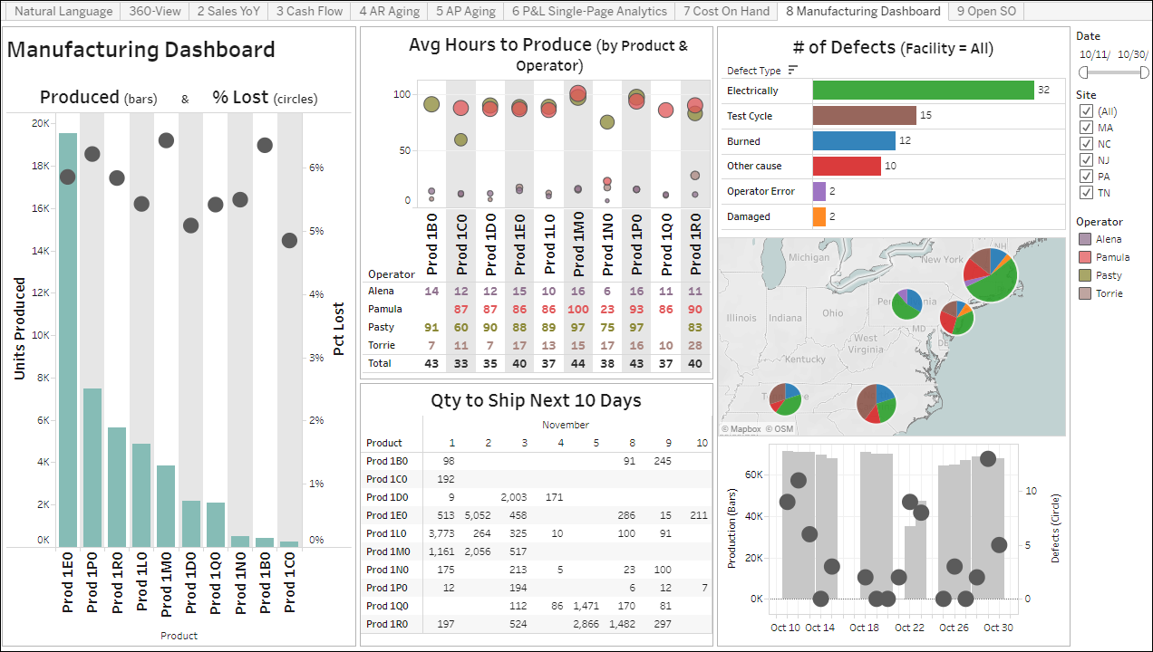

Simple is beautiful
ISO 9241-210
Source: DataSelf

Slide 50
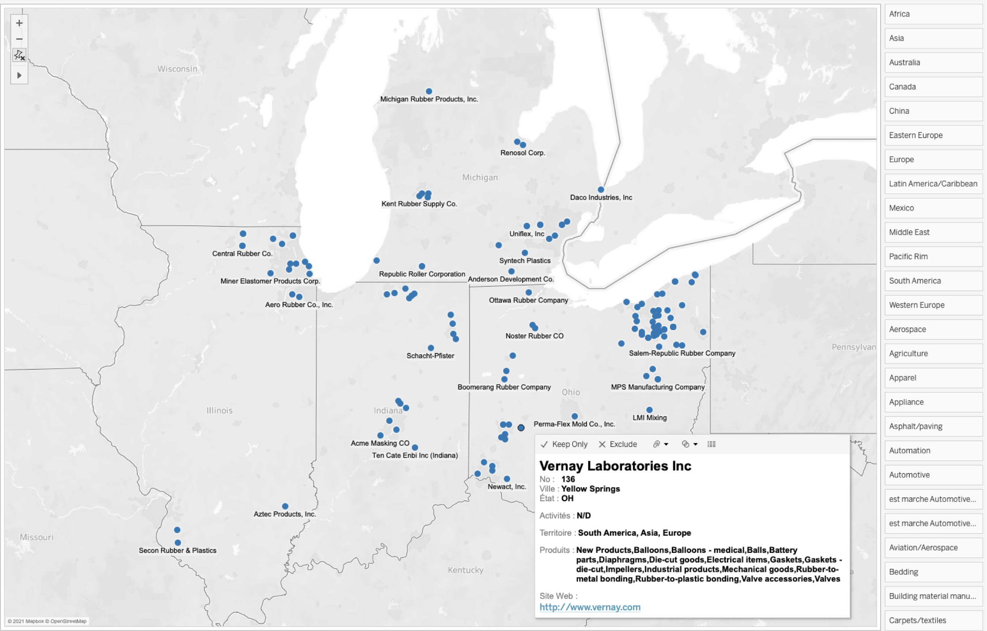


Prepare your users
TDWI maturity
Decision requirements
Gap/Feasibility analyses
Finding potential partners
Characterize businesses
Location : Mid-West

Slide 51
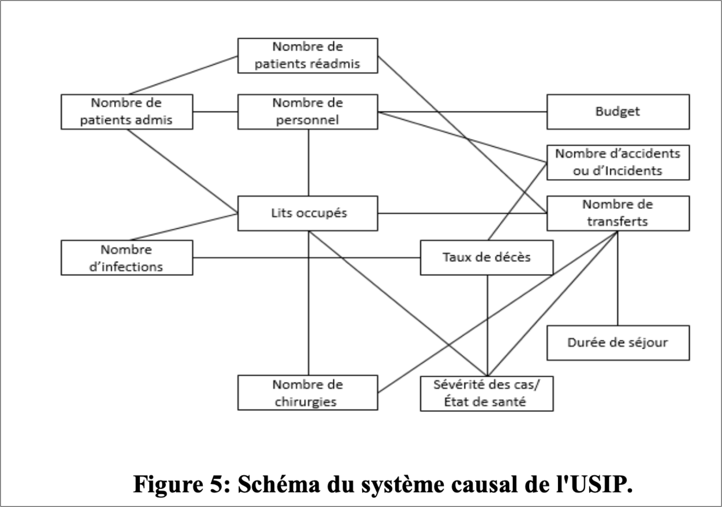
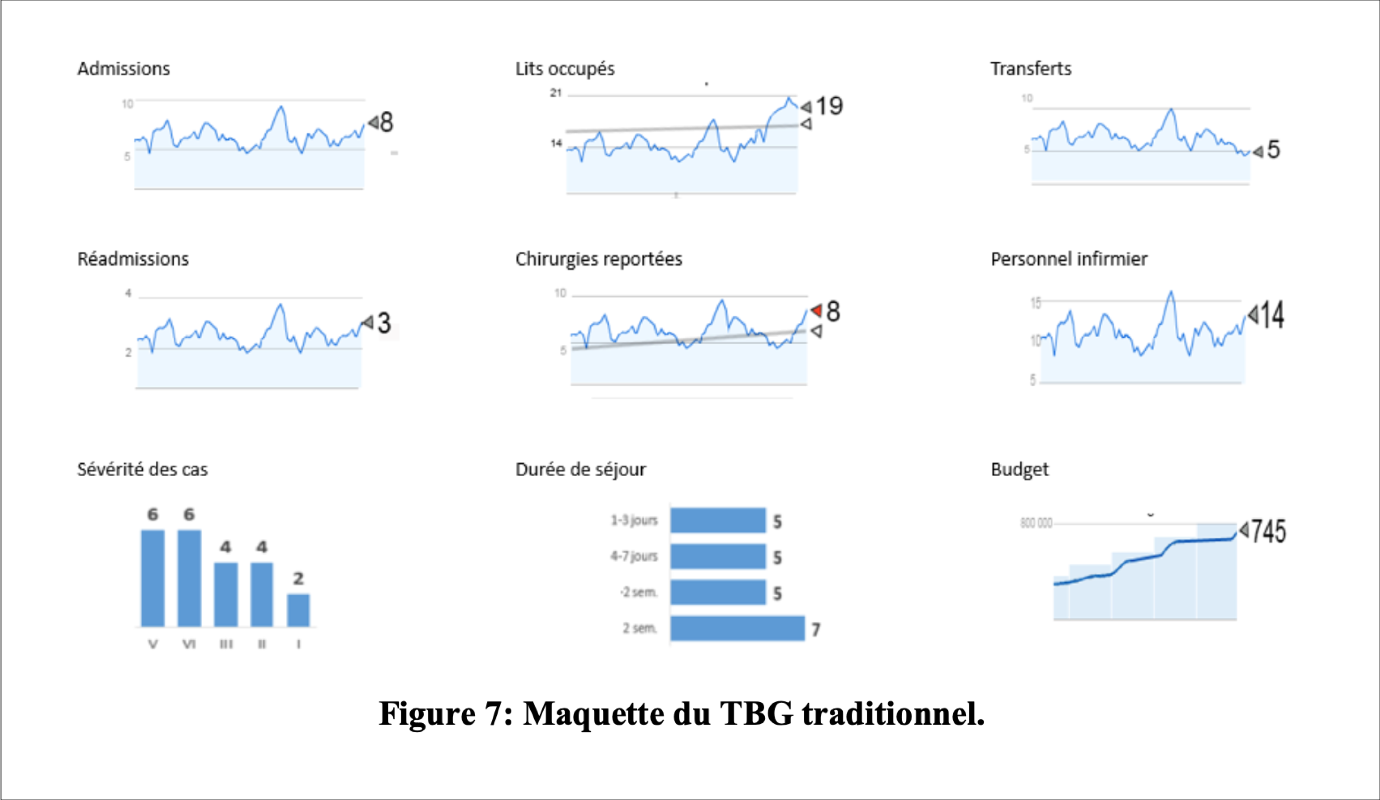
Growing in complexity
Situation awareness
Iteration 1

Slide 52
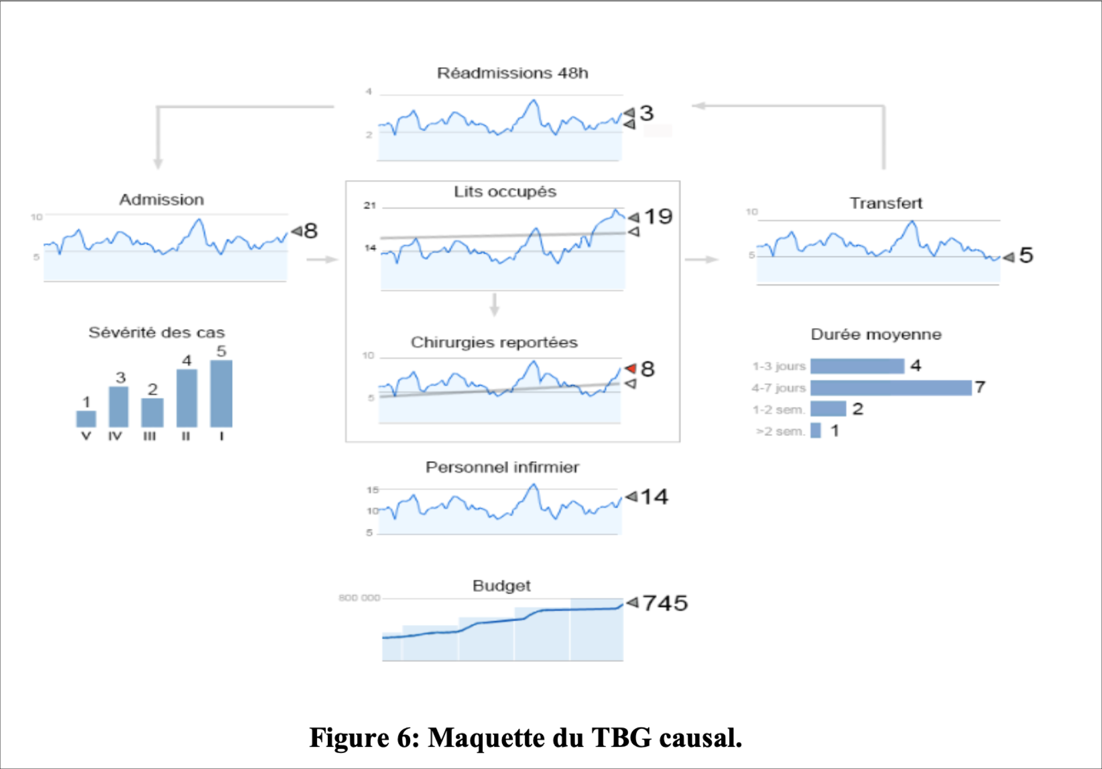
Growing in complexity
Situation awareness
Iteration 2

Slide 53
Balancing it all : The start-up
Decision requirements

Slide 54
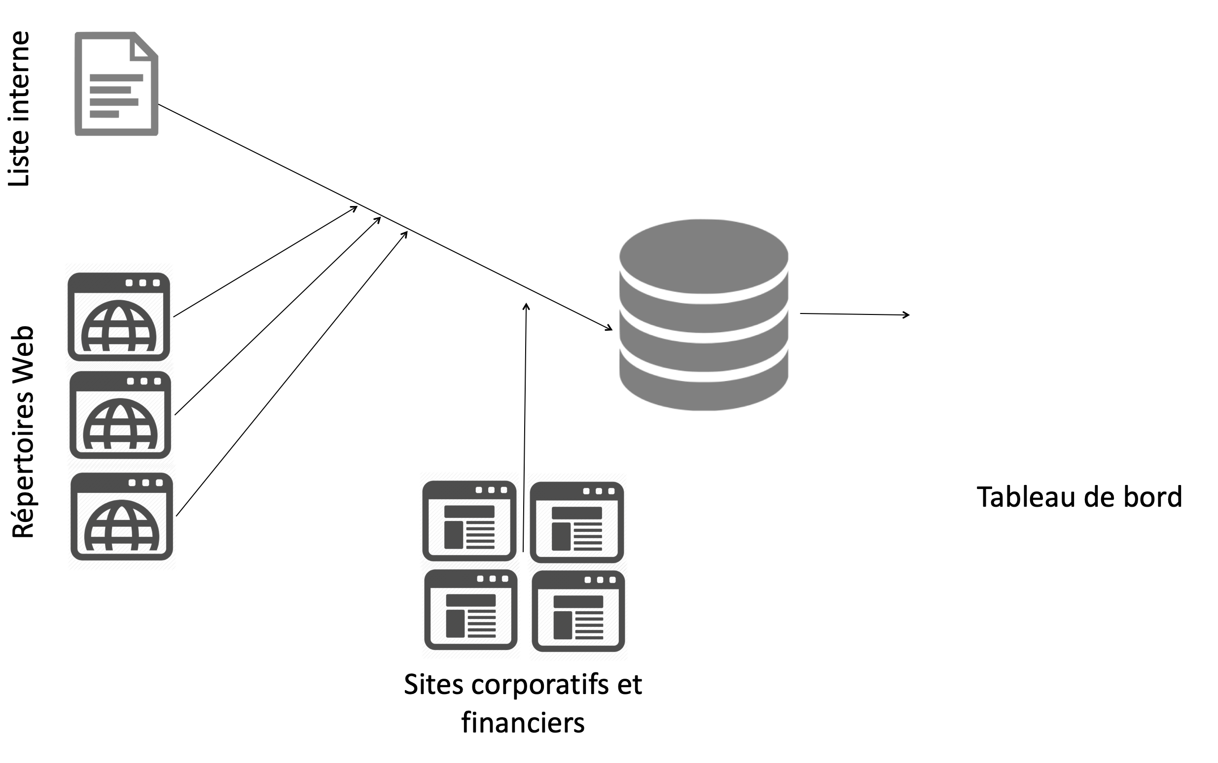
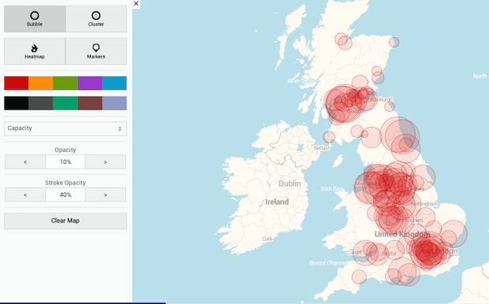
Balancing it all : The multinational
Decision requirements

Slide 55
Takeaways
Data are organizational assets
Data initiatives have formal frameworks to take from
Data initiatives should be actively managed
Opening up data can be viewed as a threat
Data products benefit from a user-centered process
… and you are not the user… nor is your client
Data products should be built iteratively
… and don’t fall in love with your data!

Slide 56
Don’t Forget… Manage data as a ASSET…

Slide 57
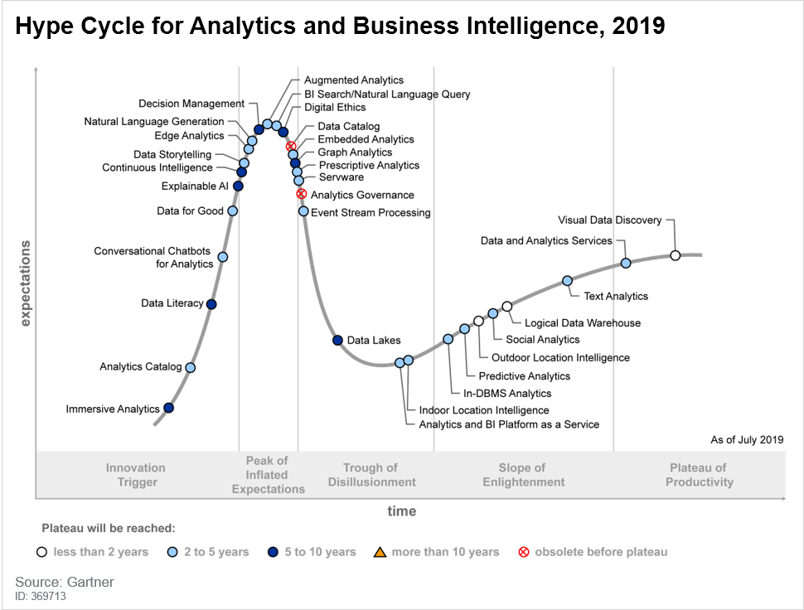
Next step: keep an eye for growing trends

Slide 58

Next step: Balance expertise
Business Intelligence at UdeS
BI Business Analyst
Data Architect
Data Analyst
Data Governance and Management Expert

Slide 59
One idea, one suggestion
I want to hear from you!

